Slide 1
Capstone Project-II Supervised ML (Regression) Bike Sharing Demand Prediction Project
Team Members:
Akshay Fasale
Kanika Kakra
Rishikesh Damale
Shubham Joshi

Slide 2
Acknowledgement
We would express our gratitude towards the entire team of “Almabetter” for acknowledging us with such important domain and providing us an opportunity to work on real life problems through Capstone Project

Slide 3
Problem Statement
Currently Rental bikes are introduced in many urban cities for the enhancement of mobility comfort. It is important to make the rental bike available and accessible to the public at the right time as it lessens the waiting time. Eventually, providing the city with a stable supply of rental bikes becomes a major concern. The crucial part is the prediction of bike count required at each hour for the stable supply of rental bikes.

Slide 4
Algorithm followed
1.Importing the necessary packages and libraries.
2.Mounting the drive for importing the data.
3.Checking for missing,NaN values,Null values.
4.Observing the datatypes .
5.Observing the correlation among independent variables.
6. Exploring the data set.
7.Exploring the categorical values, numerical features from data set.
8.Exploring different target variable.
9.Splitting the data and training the data.
10.Observing the results.

Slide 5
Data Columns
Column Name | Description
Date | Year-month-day
Rented Bike count | Count of bikes rented at each hour
Holiday | Holiday/No holiday
Functional Day | NoFunc(Non Functional Hours), Fun(Functional hours
Hour - Hour of The day
Temperature-Temperature in Celsius
Humidity - %
Rainfall - mm
Snowfall - cm
Windspeed - m/s
Visibility - 10m
Dew point temperature - Celsius
Solar radiation - MJ/m2

Slide 6
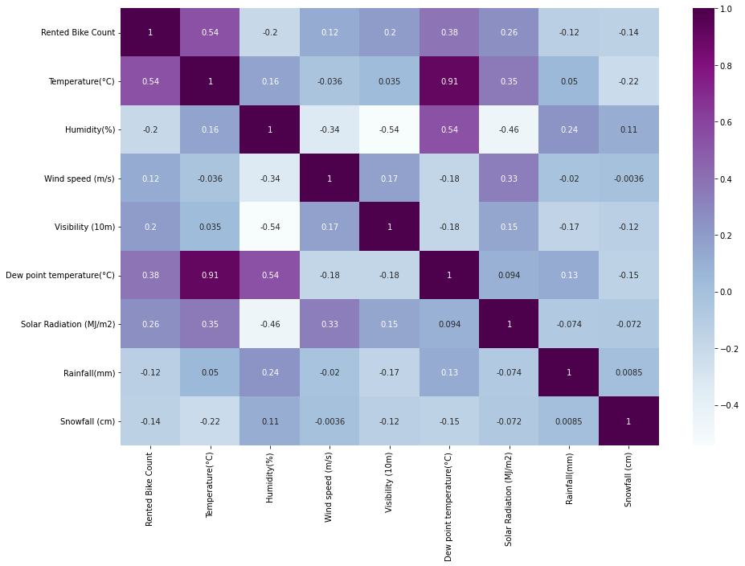
Correlation
We observe that multicollinearity between Temperature and Dew point Temperature 0.91

Slide 7
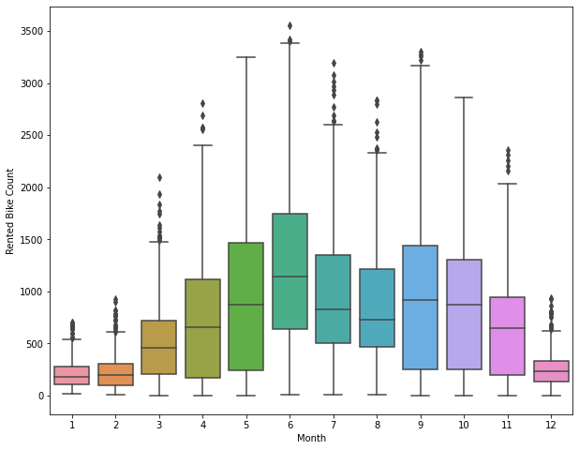
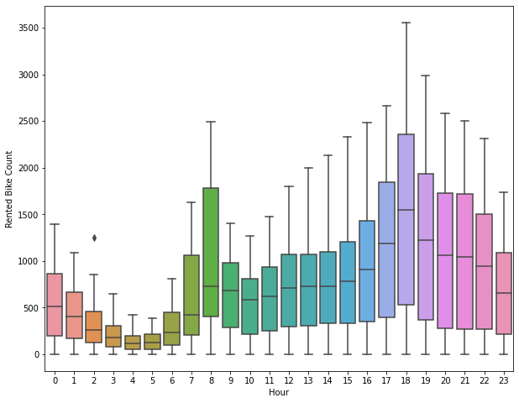
Exploring categorical features

Slide 8
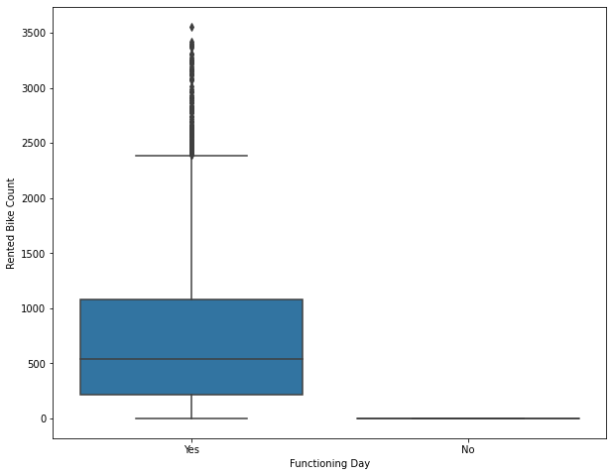
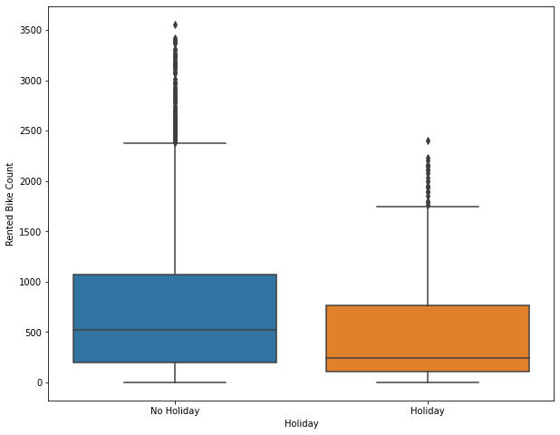

Slide 9
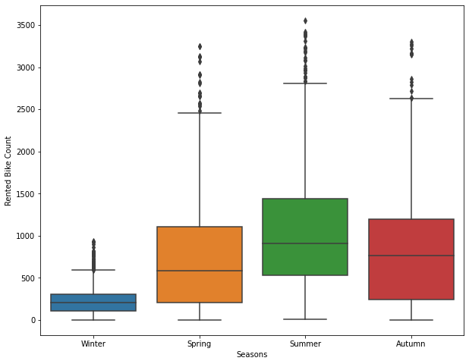
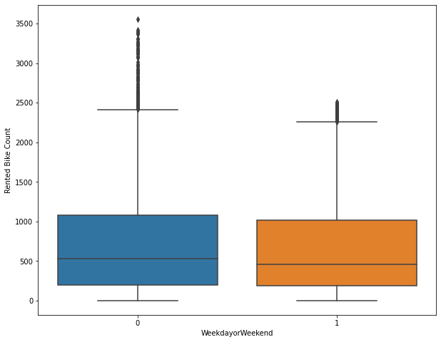

Slide 10
Conclusions drawn Less demand on winter season and more demand is in summer season. Sligthly Higher demand during Non holidays. Almost no demnad on non functioning day. Most demand for bike is in between 7 to 9 AM and 5 to 8 PM . More demand is in months May , June , July , August , september, November (Summer season) and less demand in december , January and February(Winter Season). Weekday or weekend doesnt affect the rented bike count , we will try to see on the basis of hours how it affects.

Slide 11
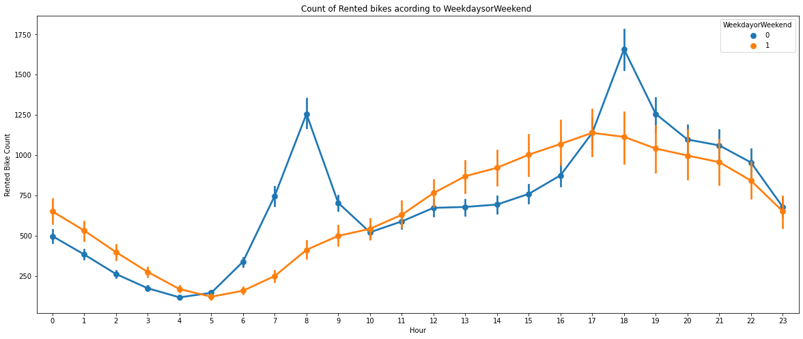
Hourly analysis for weekday or weekend
For Weekdays the count is higher in Morning 7 to 9 Am and then in the evening 5 to 8 PM
For weekends count is low in the morning but it gradually increases after 10 AM.
For Weekdays the count is higher in Morning 7 to 9 Am and then in the evening 5 to 8 PM
For weekends count is low in the morning but it gradually increases after 10 AM.
For Weekdays the count is higher in Morning 7 to 9 Am and then in the evening 5 to 8 PM
For weekends count is low in the morning but it gradually increases after 10 AM.

Slide 12
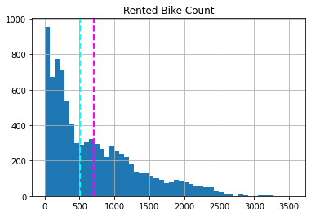
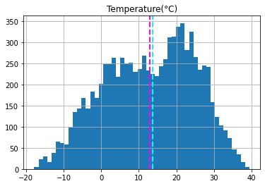
Plotting the histogram for numerical feature

Slide 13
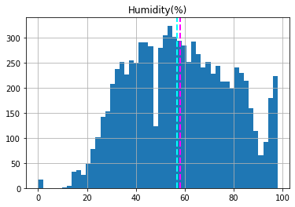
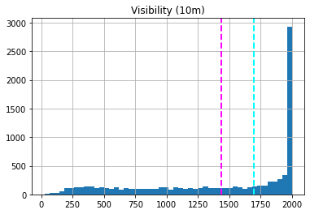

Slide 14
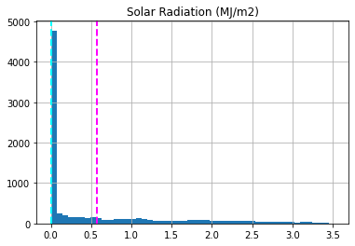
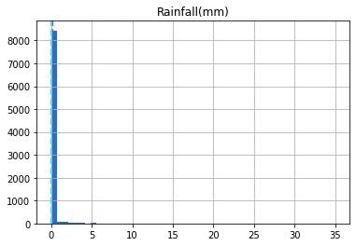

Slide 15
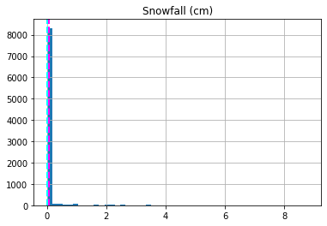
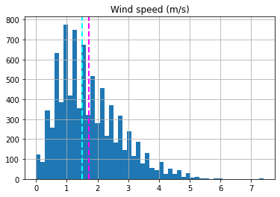
By observing 'Mean and Median' We can see the the Left or Right skewness in data.
Right skewed columns are :
Rented Bike Count (Dependent variable),), Solar Radiation (MJ/m2),Snowfall (cm),
Left skewed columns are : Temprature(degree celcius),Visibility (10m), Rainfall(mm), Wind speed (m/s

Slide 16
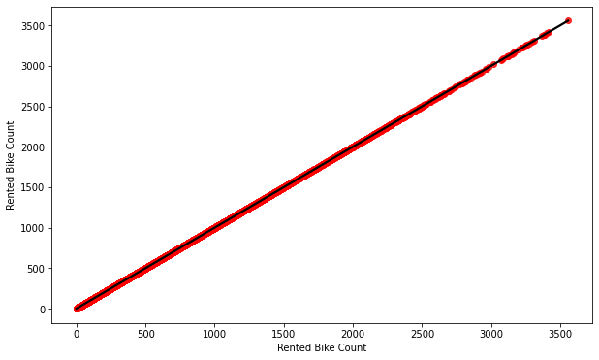
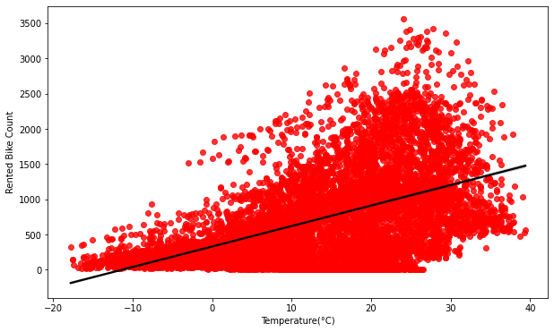
Regression plot for all numerical features

Slide 17
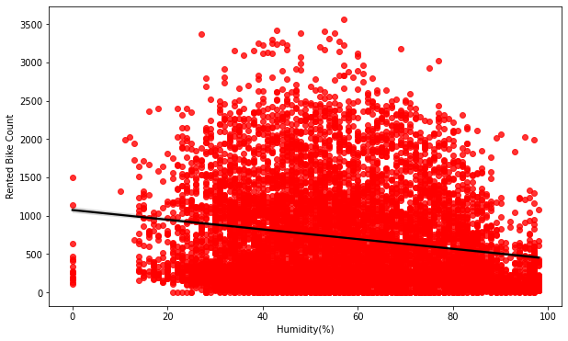
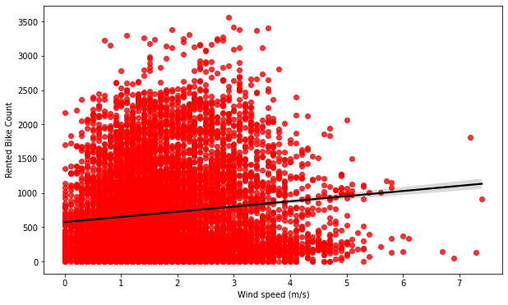

Slide 18
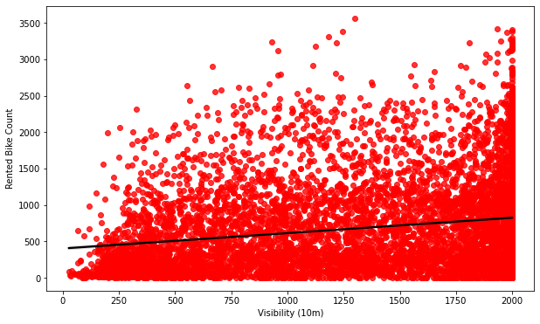
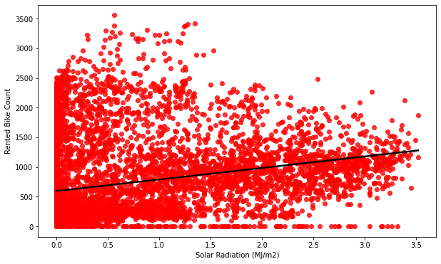

Slide 19
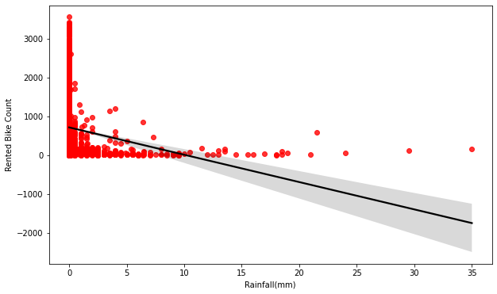
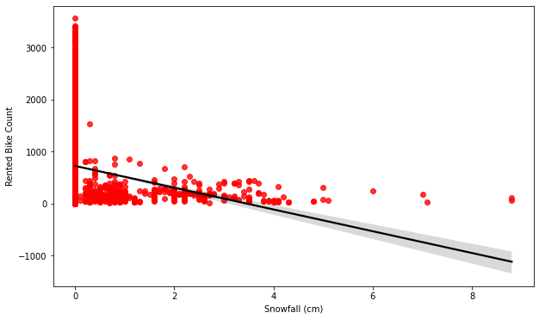
From above 'Regression Plots' we observe 'Temperature', 'Wind_speed' , 'Visibility' ,'Solar Radiation' this features are positively related with our dependent variable.
And 'Rainfall' , 'Snowfall' , 'Humidity' these features are negatively related with the dependent variable or Target variable.

Slide 20
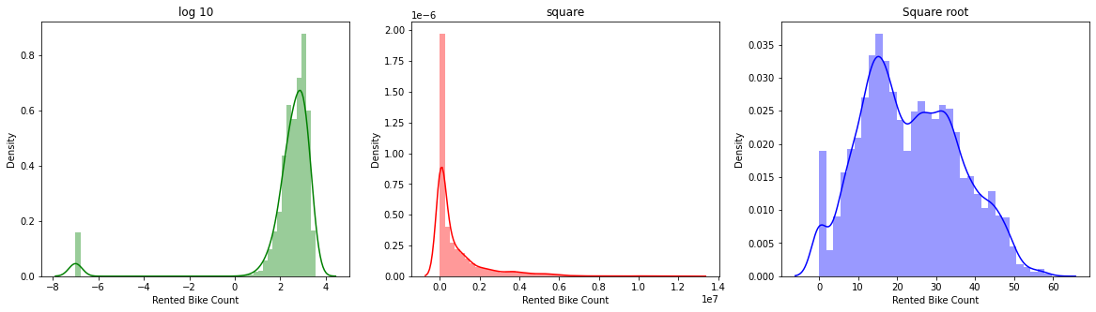
Feature Engineering
As we can see 'Square Root' tranformation is normalizing the dependent variable so we will use this transformation. As we can see 'Square Root' tranformation is normalizing the dependent variable so we will use this transformation.
We observe 'Square Root' tranformation is normalizing the dependent variable so we will use this transformation.

Slide 21
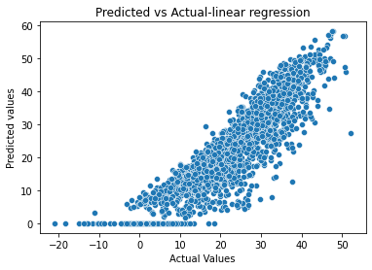
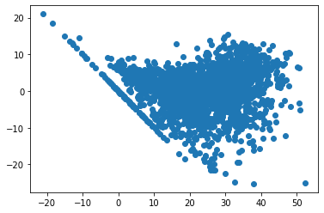
Linear Regression
Model | MAE | MSE | RMSE | R2_score | Adjusted R2
Linear regression | 4.474 | 33.275 | 5.768 | 0.772 | 0.77

Slide 22
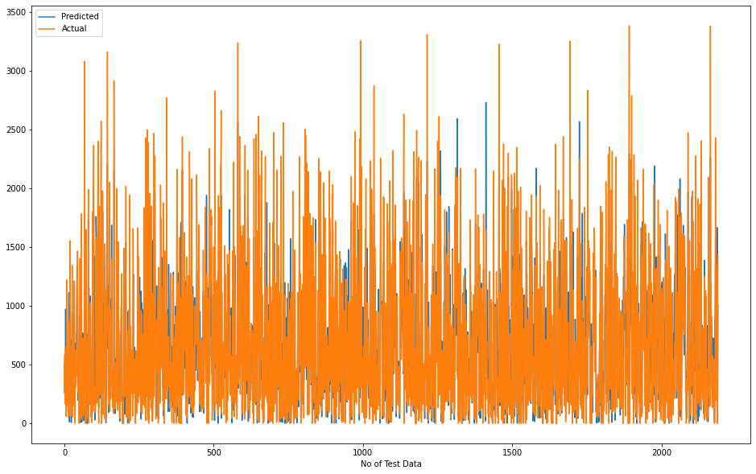

Slide 23
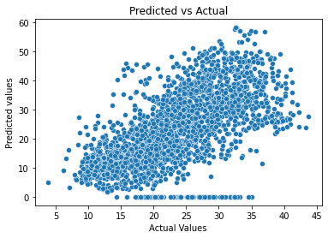
Lasso regression
Model | MAE | MSE | RMSE | R2_score | Adjusted R2
Lasso regression | 7.456 | 96.775 | 9.837 | 0.387 | 0.37

Slide 24
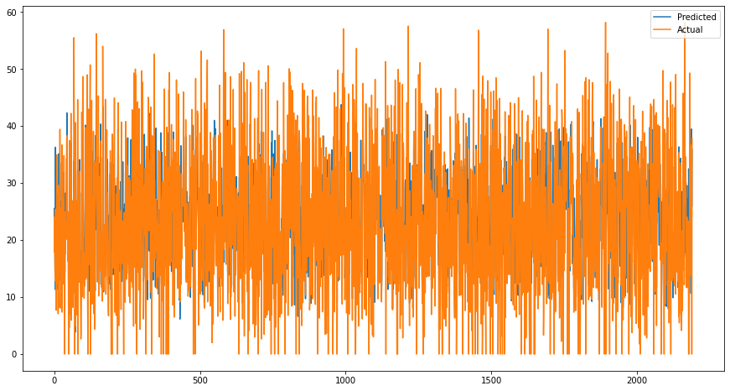

Slide 25
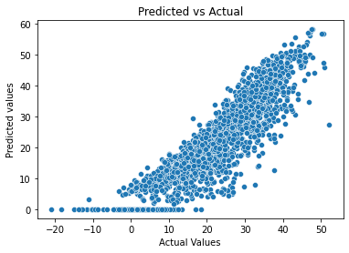
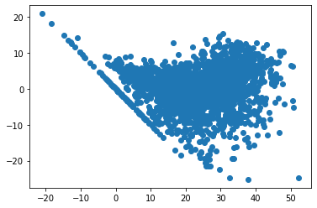
Cross Validation Lasso Regression
Model | MAE | MSE | RMSE | R2_score | Adjusted R2
Lasso regression Test with cross-validation | 4.410 | 33.276 | 5.769 | 0.789 | 0.78

Slide 26
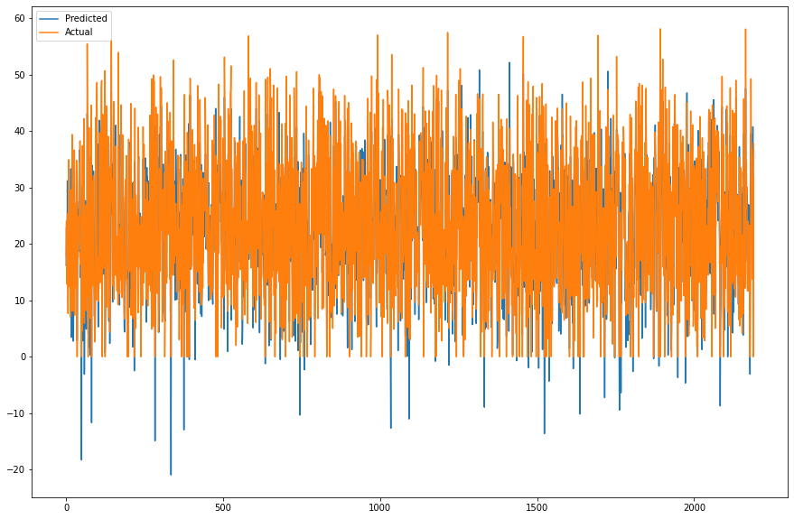

Slide 27


Ridge Regression
Model | MAE | MSE | RMSE | R2_score | Adjusted R2
Ridge regression | 4.410 | 33.277 | 5.769 | 0.789 | 0.78

Slide 28


Slide 29


Cross Validation Ridge Regression
Model | MAE | MSE | RMSE | R2_score | Adjusted R2
Ridge regression Test with cross-validation | 4.413 | 33.291 | 5.770 | 0.789 | 0.78

Slide 30
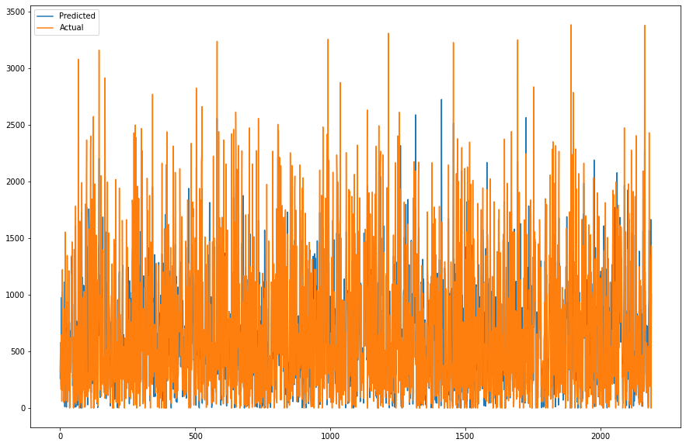

Slide 31
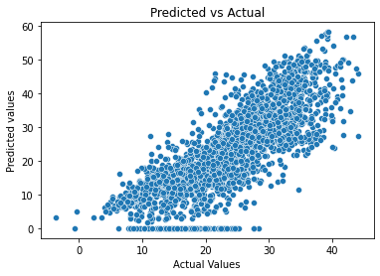
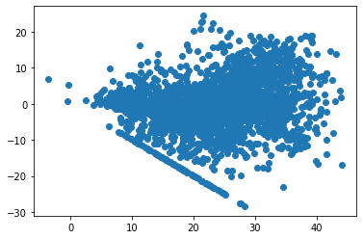
Elastic Net Regression
Model | MAE | MSE | RMSE | R2_score | Adjusted R2
Elastic net regression Test | 5.874 | 59.451 | 7.710 | 0.624 | 0.62

Slide 32
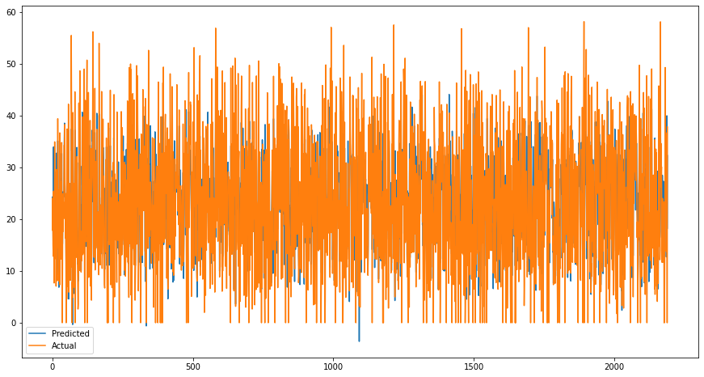

Slide 33
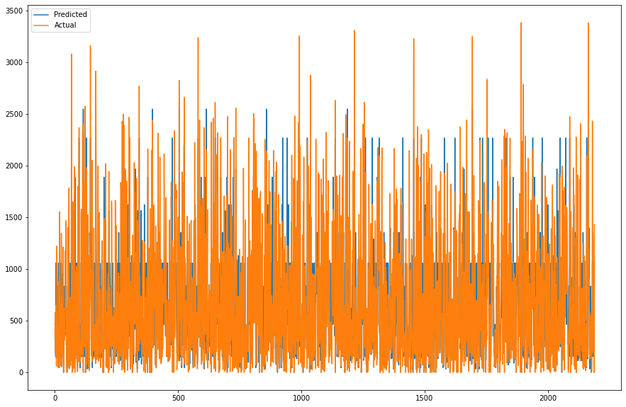
Decision Tree

Slide 34
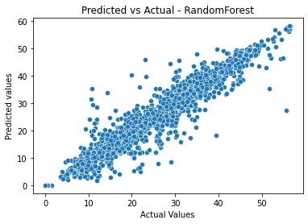
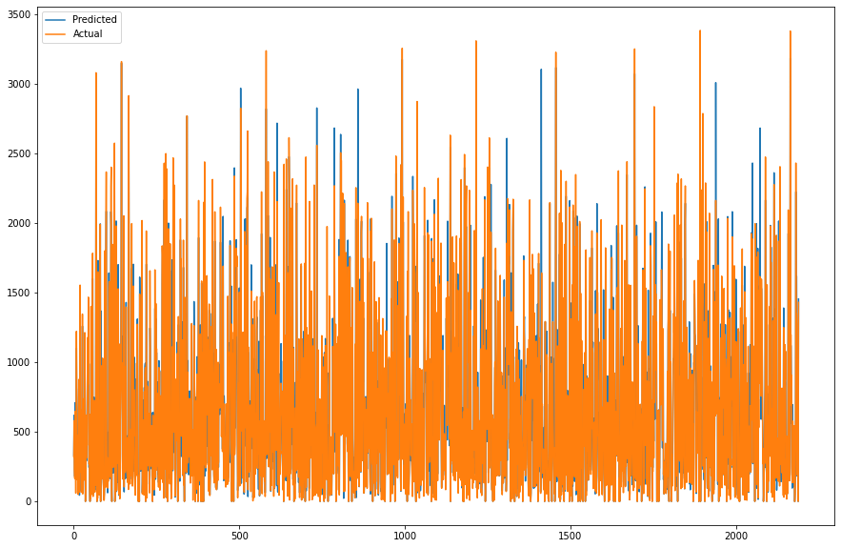
Random Forest
Model | MAE | MSE | RMSE | R2_score | Adjusted R2
Random forest regression | 2.210 | 12.634 | 3.554 | 0.920 | 0.92

Slide 35
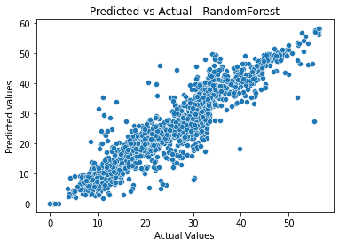
Cross Validation Random Forest
Model | MAE | MSE | RMSE | R2_score | Adjusted R2
Random forest regression with gridSearchCV | 2.785 | 17.680 | 4.205 | 0.888 | 0.89

Slide 36
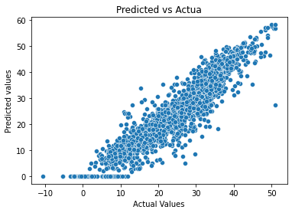
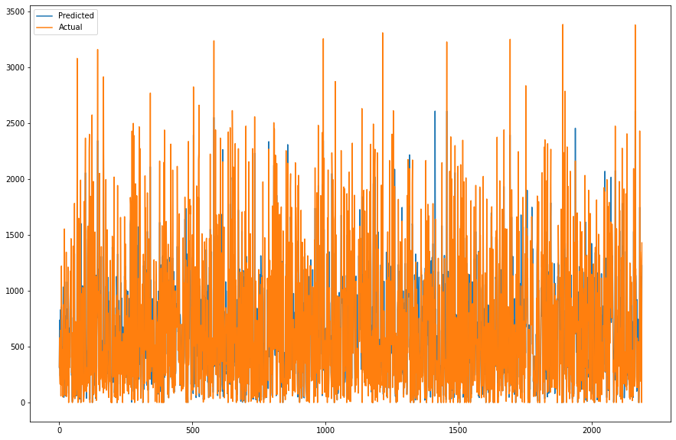
XGBoost
Model | MAE | MSE | RMSE | R2_score | Adjusted R2
XGBoost regression | 3.508 | 21.640 | 4.652 | 0.863 | 0.86

Slide 37
Conclusion
No overfitting is seen, as we can see the models are performing well with the test data with good results.
Linear Regression, Lasso , Ridge and Elastic net performed moderately and gave an R2 score of 77, 78, 78 and 62% respectively for test dataset.
Random forest Regressor, Random forest Regressor with gridsearchCV and XGB Regressor gives the highest R2 score of 92%, 91% and 86% respectively for test dataset.
Feature Importance value for Random Forest and Gradient Boost were different.
Finally, we can say that Random Forest model performed best out of all the models.

Slide 38
References
https://towardsdatascience.com/
https://www.analyticsvidhya.com/
https://www.geeksforgeeks.org/python-data-visualization-tutorial/

Slide 39
THANK YOU

